Slide 1

Data structures
HASHING
Ingrid Kirschning

Slide 2
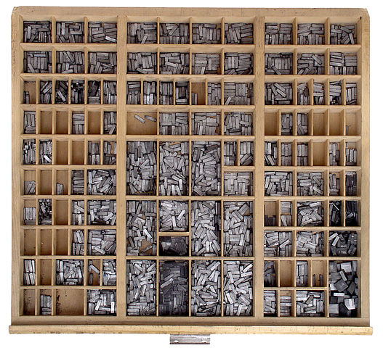
Hashing
Source: Wikimedia Commons

Slide 3
Hashing
The term hash comes, aparently, from the analogy to the meaning of mincing, chopping, and mixing.
Donald Knuth believes that H. P. Luhn, employee at IBM, was the first to use the concept in a memo dated january 1953.
Its massive use was only after 10 years later. (Wikipedia, 2014)

Slide 4
Hashing
A Hash function is a mathematical formula computable by an algorithm,
H: U → M
x → h(x),
That has as entry a set of elements, usually strings of characters or symbols,
And converts them (maps) to a specific range of values (finite).

Slide 5
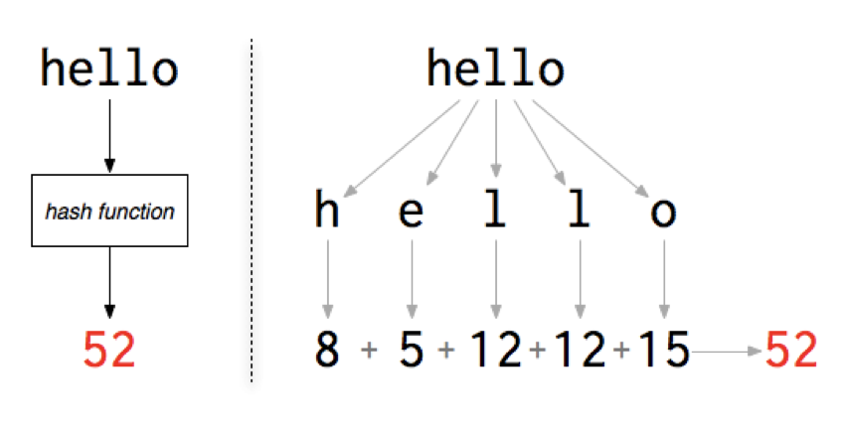
Hashing is a method to store keys.
That uses a math formula or hash function, to calculate the address where the key is to be stored.
This function can be of many types.
In this example we only use the value assigned to each letter related to its position in the aphabet. It adds them to obtain the position in the array to store the word “hello”:

Slide 6
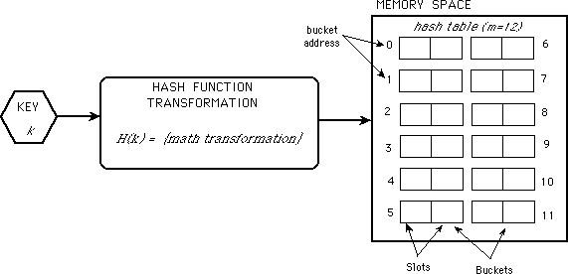

Slide 7
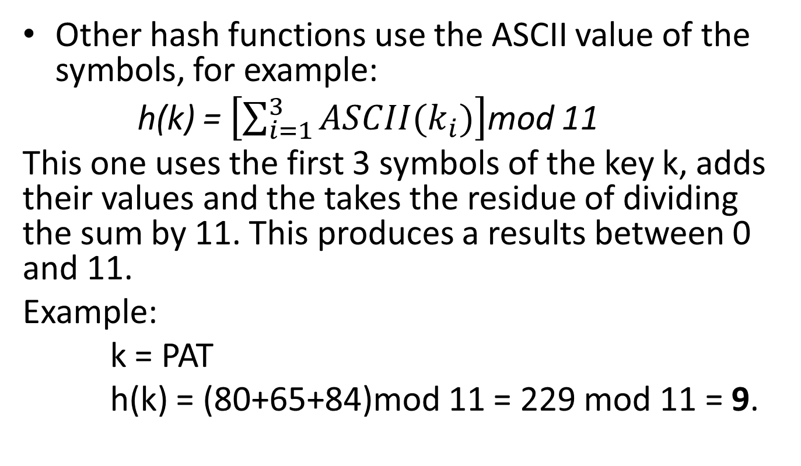
Hash Functions h(k)
Other hash functions use the ASCII value of the symbols, for example:
h(k) = $\left[\sum_{i=1}^{3}{ASCII(k_{i})}\right]$mod 11
This one uses the first 3 symbols of the key k, adds their values and the takes the residue of dividing the sum by 11. This produces a results between 0 and 11.
Example:
k = PAT
h(k) = (80+65+84)mod 11 = 229 mod 11 = 9.

Slide 8
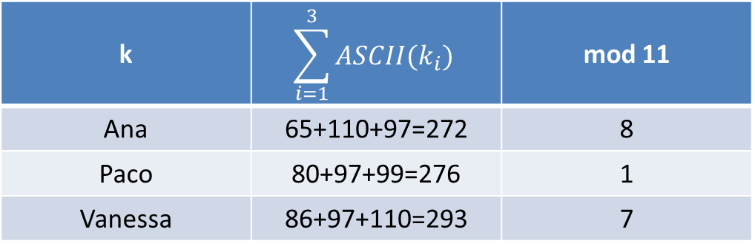
Example
k | $$\sum_{i=1}^{3}{ASCII(k_{i})}$$ | mod 11
Ana | 65+110+97=272 | 8
Paco | 80+97+99=276 | 1
Vanessa | 86+97+110=293 | 7
0
1
2
3
4
5
6
7
8
Paco
Vanessa
Ana

Slide 9
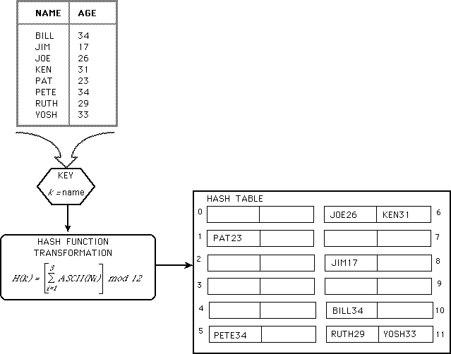
Example

Slide 10
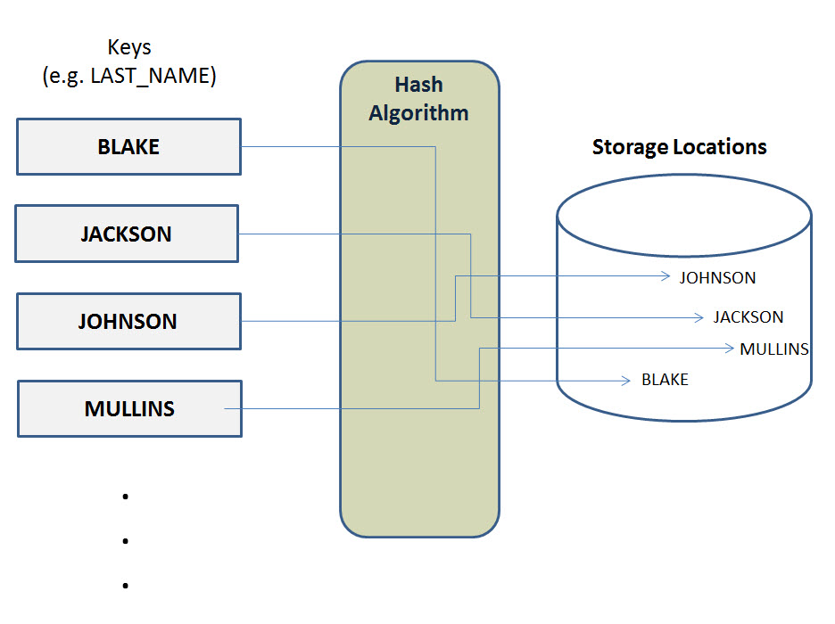
Calculating disk addresses

Slide 11
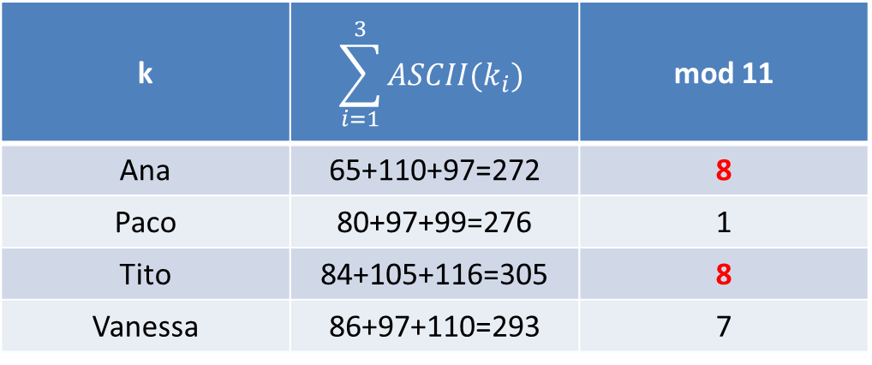
Collisions
The quality of a hash function is determined by the number of collisions it generates.
A collision is when different keys have the same hash value (i.e. would get stored in the same position).
A function that creates no collisions is called “Perfect Hashing” or “direct”.
k | $$\sum_{i=1}^{3}{ASCII(k_{i})}$$ | mod 11
Ana | 65+110+97=272 | 8
Paco | 80+97+99=276 | 1
Tito | 84+105+116=305 | 8
Vanessa | 86+97+110=293 | 7

Slide 12
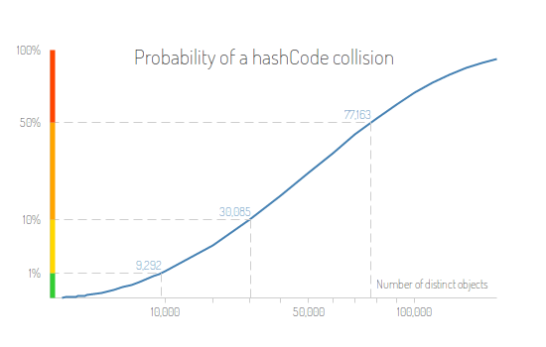
Hashing: Probablility of collisions
Collision probability
# of keys with 32 bit hash values

Slide 13
How to solve collisions
The collisions can be handles in different ways:
Open Hashing (direct chaining)
Closed Hashing

Slide 14
Open Hashing (direct chaining)
The easiest way to solve collisions is to simply créate for every position in the array a linked list to store all the keys that map into the same position.
These linked lists can be sorted or left in order of appearance.
The most common approach is to leave them un-sorted, it’s easier to program, but it should not have too many keys (requires a good hash function).

Slide 15
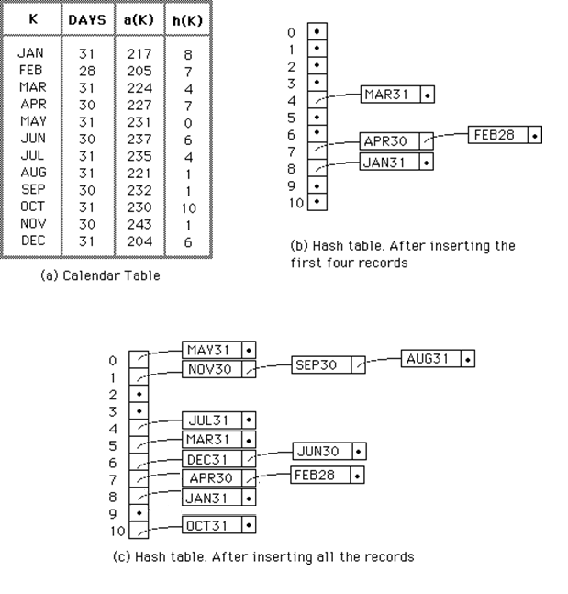
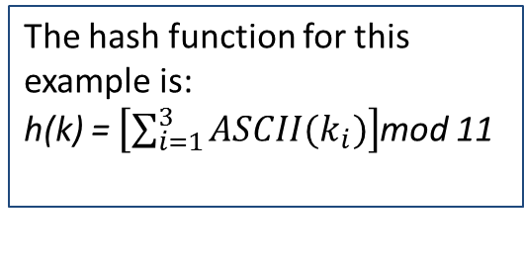
Open Hashing
The hash function for this example is:
h(k) = $\left[\sum_{i=1}^{3}{ASCII(k_{i})}\right]$mod 11

Slide 16
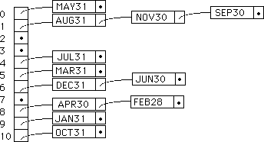
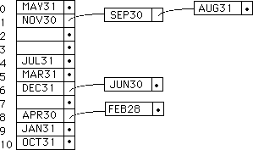
Open Hashing :Two options

Slide 17
Closed Hashing (open addressing)
If :
we have the chance to predict with enough precision how many elements will be stored in the hash table, and
we have enough contiguous memory space available to store all the keys with extra space available, then
It is not worth using a secondary structure (the linked llists) as in direct chaining / open hashing.
We then use a larger hash table.

Slide 18
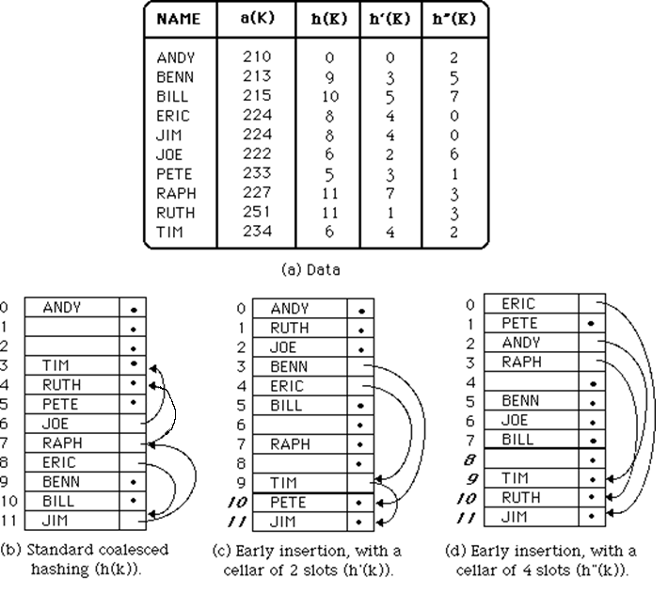
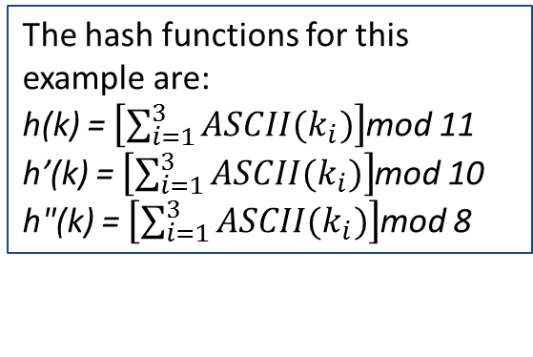
Coalesced Hashing
The hash functions for this example are:
h(k) = $\left[\sum_{i=1}^{3}{ASCII(k_{i})}\right]$mod 11
h’(k) = $\left[\sum_{i=1}^{3}{ASCII(k_{i})}\right]$mod 10
h"(k) = $\left[\sum_{i=1}^{3}{ASCII(k_{i})}\right]$mod 8
12

Slide 19
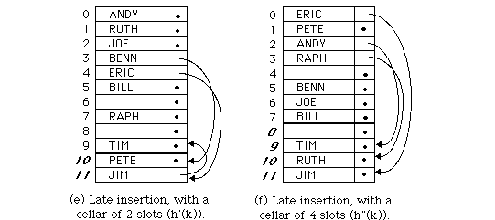
Late Insertion with slots

Slide 20
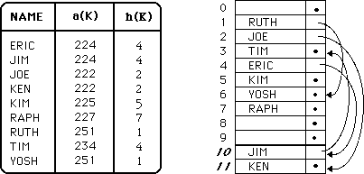

Slide 21
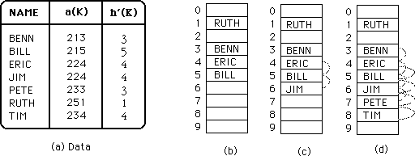
Late Insertion without slots

Slide 22
Re-Hashing
When the tables become too full, execution time becomes very long.
A solution for this is to créate another table, doublé the size, (with a new hash function) and process the original hash table again..
This operation is called re-hashing.
It is obviously a coslty operation, but given that it does not happen frequently, it is a viable solution and it’s effect is almost unnoticed.

Slide 23
Hashing
https://code.google.com/p/guava-libraries/wiki/HashingExplained

Slide 24
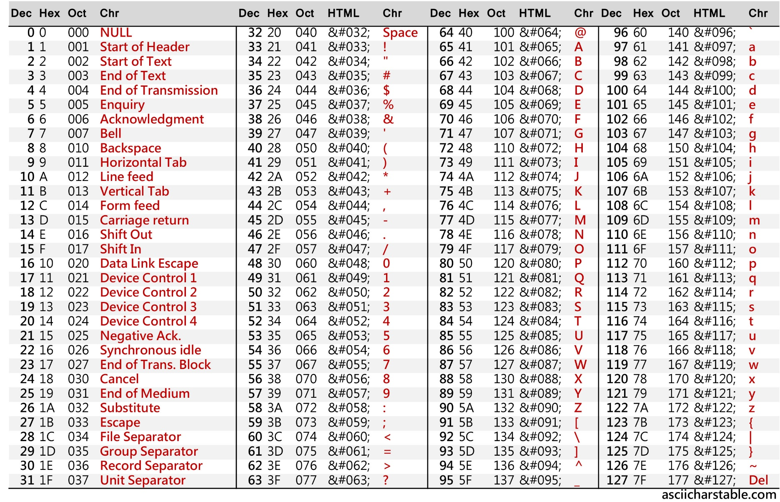
ASCII Table

